Slide 1
The Added Value of Allied Health Management and Leadership
Dr Robert Jones & Fiona Jenkins
JJ Consulting
Healthcare Management Ltd

Slide 2
Objectives
To support AH managers and leaders demonstrate added value of their roles
To focus on the healthcare provision context
What’s unique about AH managers and leaders?
When do we use the arguments?
Networking
Action planning

Slide 3
Parking Issues

Slide 4
What changes are you facing?
Make a list, then prioritise the top 3 from your group

Slide 5
Re-structuring
Infinite Demand
Reorganisation

Slide 6
Change
What is your role as an Allied Health leader in this time of change?

Slide 7
How is change affecting
The organisation?
Your service?
Your staff?
You?
Your role as an Allied Health leader?

Slide 8
What is the specific contribution of Allied Health Managers and Leaders in Healthcare?
What is unique about Allied Health?

Slide 9
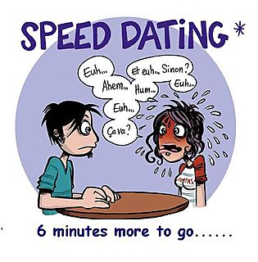
Round table “speed dating”

Slide 10
The Rules
4 topics related to Allied Health influencing
4 Work tables:
Strategy
Data
Audience
Deployment: How to make an idea work

Slide 11
How to “Play”
Find a table ( not with ALL your friends)
Discuss the topic (listen to prompts from your facilitator)
Write down on a post it ideas that you may have
Ideas must be solutions not problems
Rate them as Boston quadrant 1,2,3, or 4
Go and stick them on the appropriate quadrant on the flip chart
When “time” is called- move promptly to the next table….and repeat X4

Slide 12
Boston Box
IMPACT | HIGH | 1 | 2
IMPACT | LOW | 3 | 4
 |  | EASY | DIFFICULT
 |  | ACHIEVABILITY

Slide 13
AH Managers Unique?
Clinical heads of clinical services
Credibility
Extensive knowledge
Patient centred approach
Evidence base interpreters
Knowledge of health diversity
Expert staff managers
Strategic thinkers
Practical “doers”
Problem solvers

Slide 14
AH Managers - really unique?
Code of Ethics = Integrity
Experience = Whole system approach
AH = Patient centredness
Regulated = Registered by the state

Slide 15
Allied Health managers bring:
Knowledge of clinical specialties
Public health knowledge
Problem solving skills
Effective and efficient service planning
Clinical credible management and leadership
Rehabilitation and integrated care
Effective demand management
Innovative solutions
Team working
Business skills
Notes:
Comprehensive knowledge of wide range of clinical specialties in acute, community and tertiary care
Comprehensive understanding of illness, disease, trauma and their treatments
Wide understanding of public health and prevention
Problem solving skills developed through extensive clinical knowledge and practice (can be used in clinical and managerial situations
Effective and efficient service planning and provision
Clinical credible management to facilitate service change with the M.D team across whole pathways of care
Leadership of rehabilitation and integrated care that can facilitate safe timely discharge
- Effective demand management with cost efficient and clinically effective solutions
- Innovative solutions to clinical and managerial problems across the whole spectrum of patient care
- Effective team working developed through a culture of multi and interdisciplinary working
- Contribution to business cases based on clinical experience, expertise and knowledge

Slide 16
Added Value Key Roles
Patient Centred care
Patient safety
Strategic management and planning
Operational management
HR management
Clinical leadership
Resource management and efficiency
Clinical effectiveness/ evidence based
Relevant performance management
Education/training skilled workforce
Professional networking
IM&T

Slide 17
What to do next
Make sure you are up-to-date
Have your annual development review
Identify your training needs
Address any where you need development
Ensure your CV is updated
Review your leadership competencies
Network with other AH
Make use of your networks
Ensure you are familiar with wider healthcare politics, nationally and locally

Slide 18
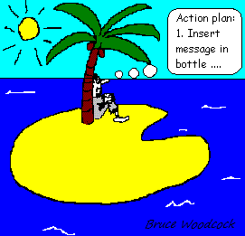
Action plan
What next?

Slide 19
Some Resources for you

Slide 20
Any Final Questions?

