Slide 1


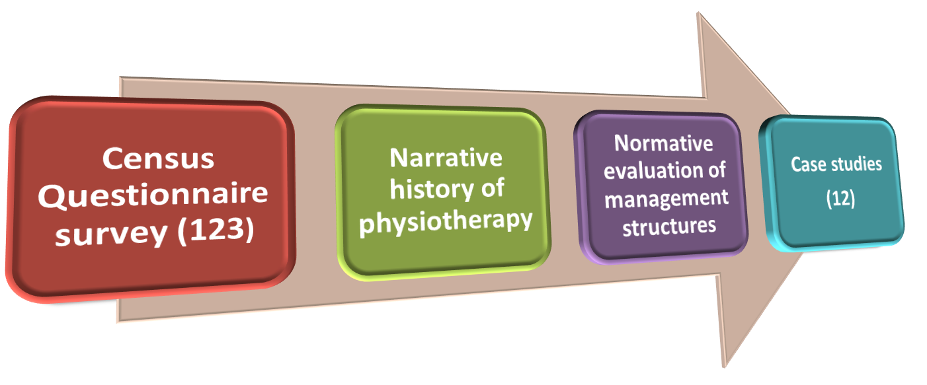
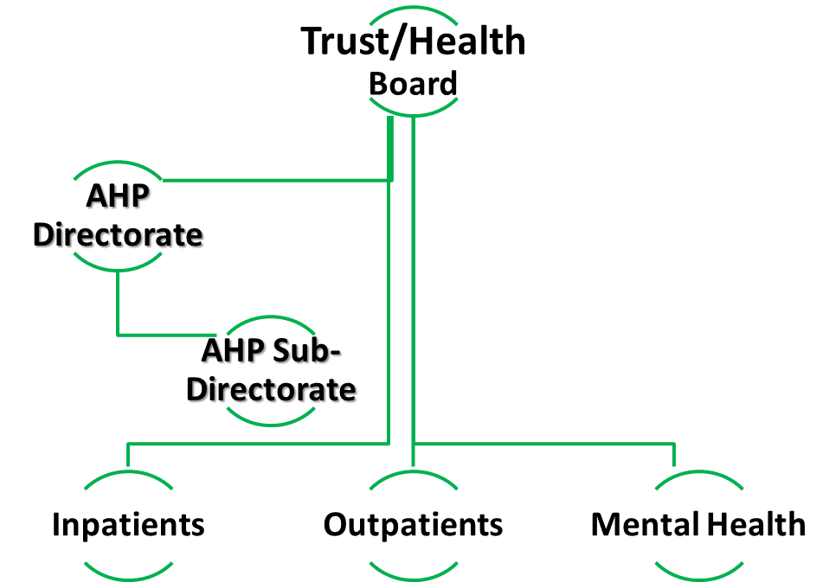
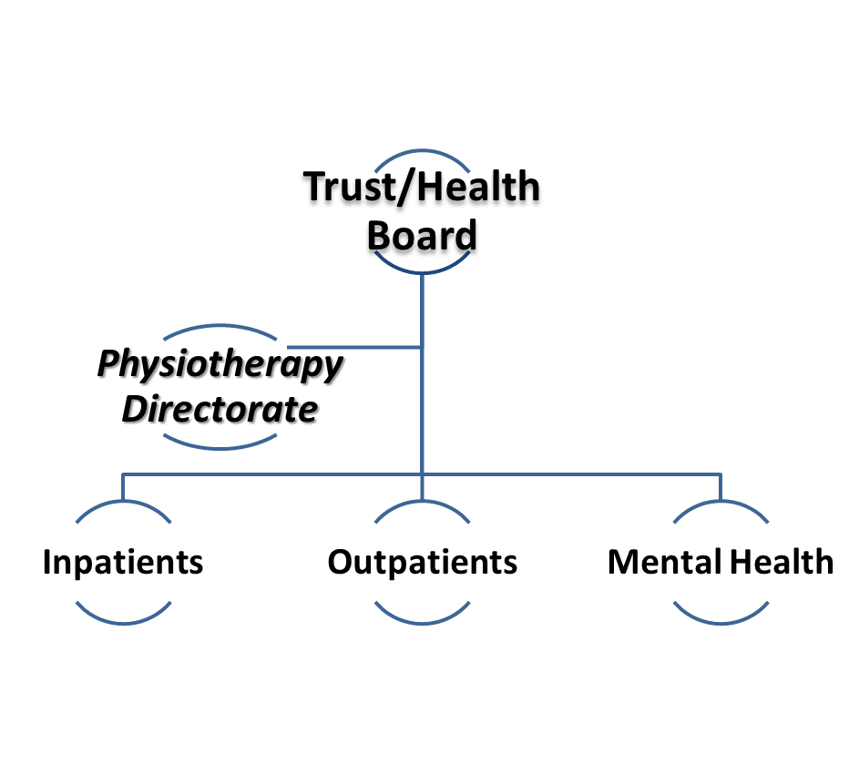
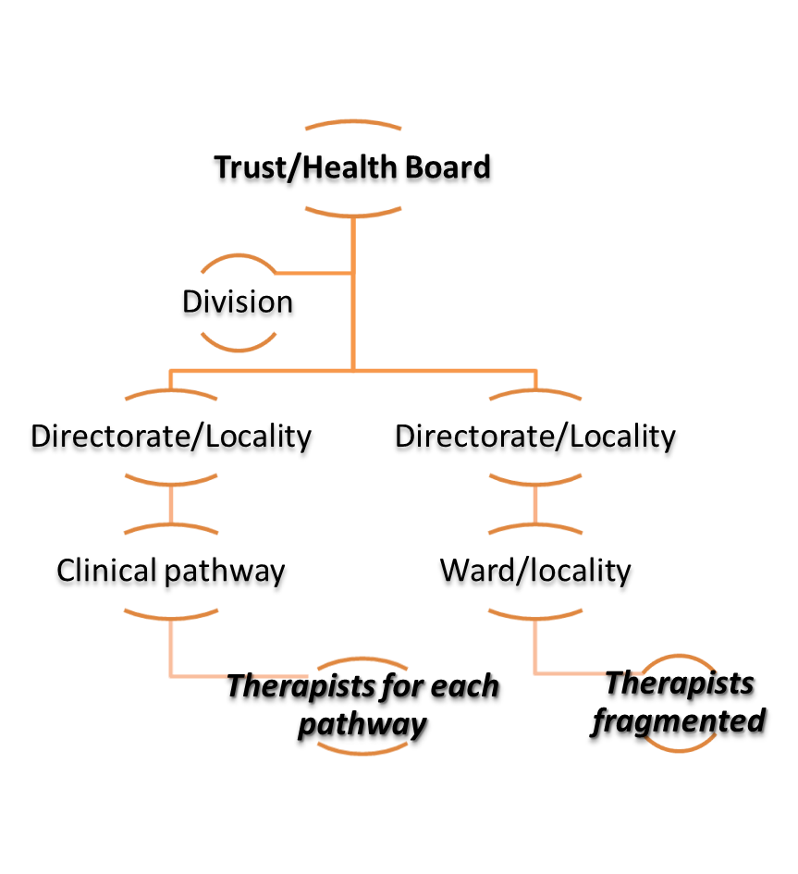

Professional Management:
PHYSIOTHERAPY ORGANISATIONAL STRUCTURES
Fiona Jenkins PhD, MA, FCSP, Grad.Dip.Phys., CIHM
Executive Director: Therapies, Health Science & IT Cardiff and Vale University Health Board UK
Director: JJ Consulting Healthcare Management Ltd. UK
Background
Overall Management Structure Assessment
Physiotherapy managers ranked the AHP Directorate model the highest, and the fragmented structure the lowest.
Patient outcomes and experience are influenced by the way physiotherapists are organised and managed. A changing health reform agenda has frequently challenged management arrangements for physiotherapy. Impacts are documented for medicine and nursing but much less so for the United Kingdom’s third largest profession, physiotherapy. This PhD study contributes to the management evidence-base for physiotherapy management and thereby the quality of care for patients.
Purpose
To evaluate the impact of health service reforms on physiotherapy analysing the resulting management structures in England and Wales and the impact of different models of management structure and their impact on patient care, staff development and manager’s roles.
Sepucha K, Ozanne E, Silvia K, Partidge A, Mulley AG (2007) An approach to measuring the quality breast cancer decisions. Patient Educ Couns, 65 (2): 261-9
Methods
An observational mixed methods research design.
Conclusions and Implications
RESULTS
Management structures
Model 1 Allied Health Professional
Directorate (43%)
Model 2 AHP Sub-
Directorate (4%)
  Model 3 Physiotherapy Directorate(26%)
Most physiotherapists were managed within allied health profession (AHP) structures
A preference for professionally-led models of organisation was widely reported
Devolved and fragmented structures were increasingly emerging but physiotherapists reported a preference for professionally-led structures due to improved patient outcomes and experience
The type of structure influenced the governance arrangements, the potential for staff development, access to specialist physiotherapists and ultimately the quality of care to patients
An understanding of the roles, responsibilities and functions required to effectively manage a physiotherapy service to provide good patient experience, as well as the merits of different management structures will enable the profession to influence its management arrangements when faced with organisational restructuring.
To improve patient care physiotherapists would do well to consider being organised with other AHPs to give critical mass and strengthened governance.
References
Jenkins F.C (2015) An Investigation Into The Effects of NHS Reforms on the Management and Provision of Physiotherapy Services In England And Wales. PhD Thesis. Plymouth University.
Jenkins, F., Jones, R. (2011) Our Assessment Tool for Evaluating AHP Management Structures. In Jones, R., Jenkins, F. (2011) (eds). Key Tools and Techniques in Management and Leadership of the Allied Health Professions. London: Radcliffe Publishing Ltd
Model 5 Pathway (19%)
Model 6 Fragmented (8%)
Acknowledgement
Presented at the WCPT Congress 2017, Cape Town
Contact Details
Email: fiona.jenkins3@wales.nhs.uk
Web site: http://jjconsulting.org.uk

